Slide 1
Grammar Revision
Comma Splices, Run-on Sentences and Fragments

Slide 2
Learning Outcome: I CAN WRITE PROPER SENTENCES WHILE AVOIDING RUN-ONS, COMMA SPLICES, AND FRAGMENTS.
SUCCESS CRITERIA:
I CAN IDENTIFY SENTENCES THAT INCLUDE RUN-ONS, COMMA SPLICES, AND FRAGMENTS.
I CAN EDIT SENTENCES THAT INCLUDE RUN-ONS, COMMA SPLICES, AND FRAGMENTS.
I CAN FORM SENTENCES THAT DO NOT INCLUDE THE ERRORS MENTIONED ABOVE.

Slide 3
Preassessment: Fill in the blanks (3 min)
A sentence is a group of words expressing a ____complete_________thought.
A sentence is made up of ______sub_________ and ____verb
Each clause must have a ____sub_________ and a ____verb_________
There are ________dep_______ and ____________indep_____ clauses.
A(n) _________ind_______ clause can stand alone and expresses a ________comp___ thought.
A(n) _______dep______ clause cannot stand alone and doesn’t express a ___comp________ thought.
A(n)__dependent____________ clause has a __subordinating y_____________ conjunction at the beginning.
Note: The list of subordinating and coordinating conjunctions is found on LearnOnline.

Slide 4
S.C.1
I CAN IDENTIFY SENTENCES THAT INCLUDE RUN-ONS, COMMA SPLICES, AND FRAGMENTS.

Slide 5
What is a fragment?
A group of words that does NOT express a complete thought because…
1….it is missing a subject. (e.g. cared for his younger siblings)
2….it is missing a verb. (e.g. Jane playing outside)
3…it is missing both a subject and a verb. (e.g. studying alone last night/under the bed)
4…it is a dependent clause. (e.g. because I am sick/whenever you are away)

Slide 6
How do I fix a fragment?
I add to the fragment whatever is missing:
Jack cared for his younger siblings. (I added a subject)
Jane is playing outside. (I added a verb).
Sam was studying alone last night
The cat sat under the bed.
(I added both a subject and a verb).
4. Because I am sick, I won’t go to school.
I am lonely whenever you are away.
(I added an independent clause)

Slide 7
What is a run-ons sentence?
It is when the two independent clauses are fused together without any conjunction or punctuation mark.
e.g. There were many food stands in the park Mark couldn’t decide from which one to buy.
e.g. I spoke to the manager he said I needed to be more serious.
What is a comma splice?
It is when the two independent clauses are fused together only with a comma.
e.g. There were many food stands in the park, Mark couldn’t decide from which one to buy.
e.g. I spoke to the manager, he said I needed to be more serious.

Slide 8
How do I fix a run-on or a comma splice?
You add a full stop.
I spoke to the manager. He said I needed to be more serious.
You add a semi-colon.
I spoke to the manager; he said I needed to be more serious.
You add a comma followed by a coordinating conjunction (FANBOYS).
I spoke to the manager, and he said I needed to be more serious.
You add a conjunctive adverb.
I spoke to the manager; all in all, he said I needed to be more serious.
You add a subordinating conjunction.
I spoke to the manager since he said I needed to be more serious.

Slide 9
S.C.2
I CAN EDIT SENTENCES THAT INCLUDE RUN-ONS, COMMA SPLICES, AND FRAGMENTS.

Slide 10
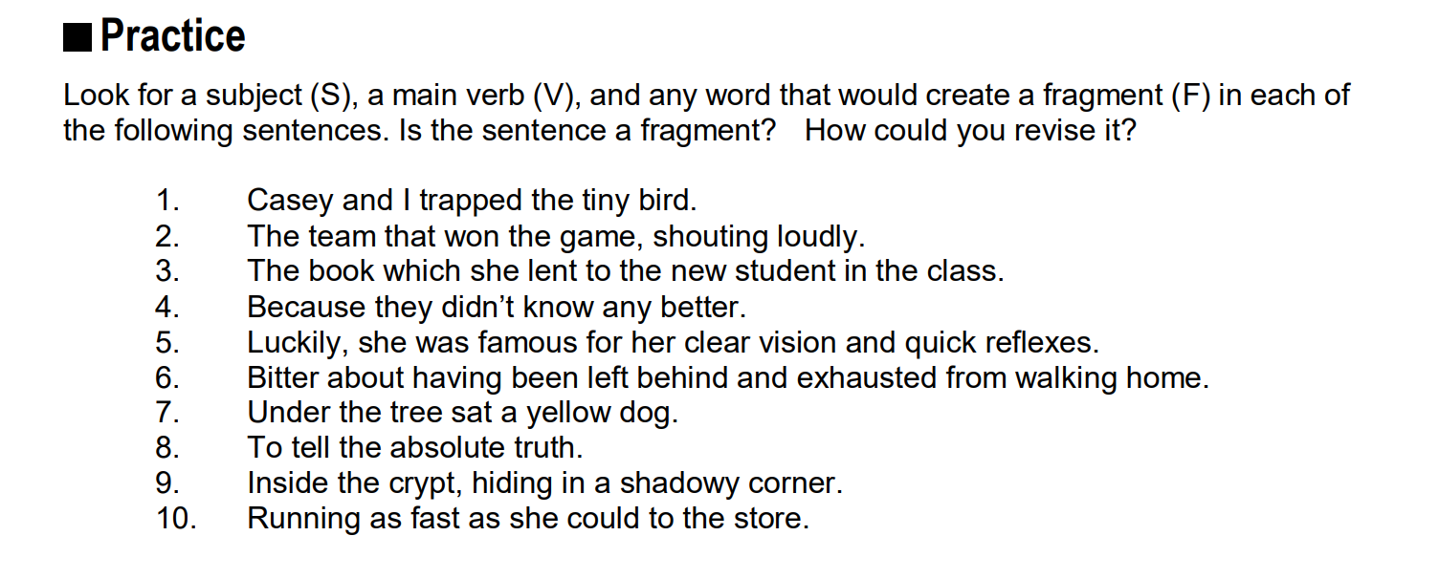
Fragments: Practice 1
s
f
s
v
f
v
s
s
f
v

Slide 11
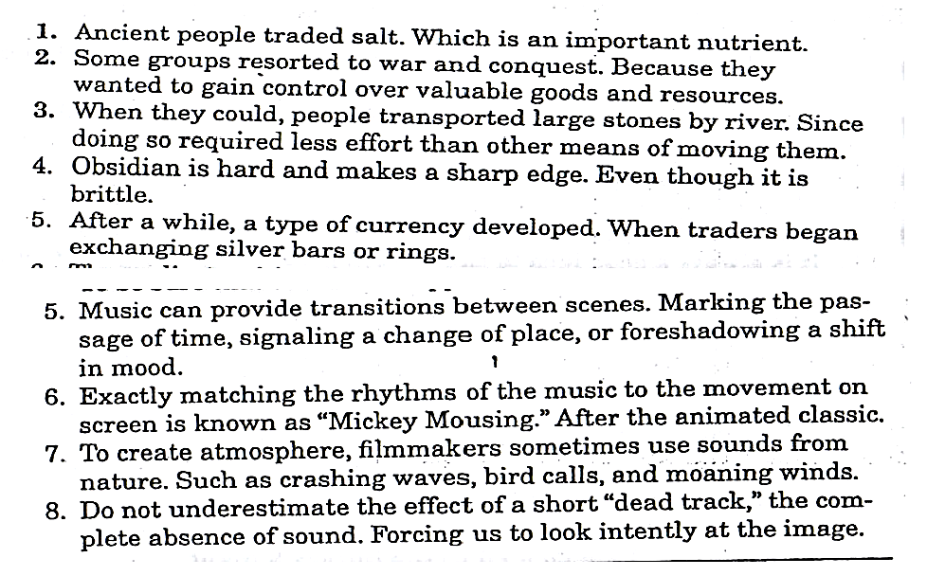
Fragments: Practice 2

Slide 12
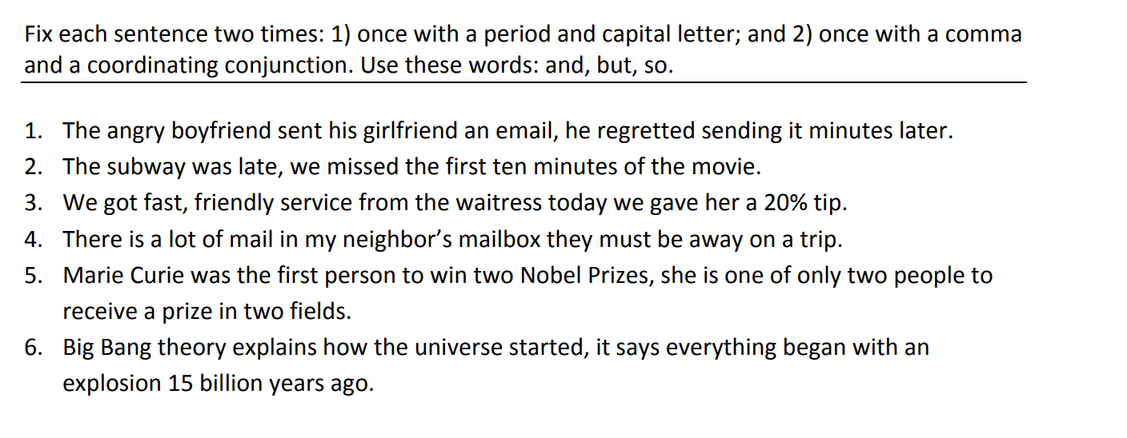
Run-ons & Comma Splices: Practice 3
Fix the run-ons and comma splices

Slide 13
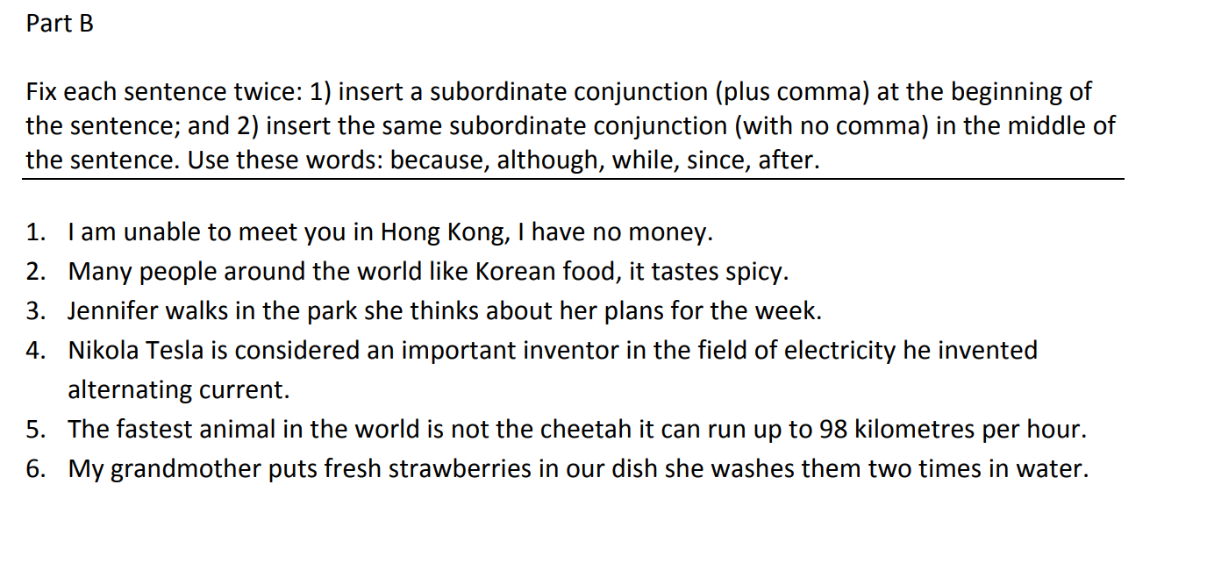
Run-ons & Comma Splices: Practice 4
Fix the run-ons and the comma splices

Slide 14
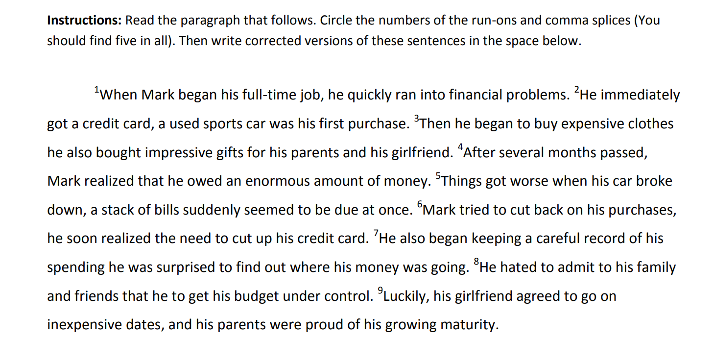
Run-ons & Comma Splices: Practice 5

Slide 15
S.C.3
I CAN FORM SENTENCES THAT DO NOT INCLUDE THE ERRORS MENTIONED ABOVE.

Slide 16
Practice: work on one of the three worksheets in which ever order you like.
Play the grammar “Whodunnit SC3” game to find out the killer. (The worksheet is on Learn Online)
Grammar Practice Worksheet SC3. (The worksheet is on Learn Online)

